Slide 1
Automation of ServiceEnablement Emails (BI AMS Factory – Monitoring Team)

Slide 2
Problem Statement
Cause : Service enablement mails are automatically triggered when MDP server goes down and henceforth, records/Items will not get processed.
Since 6 months, we have received 17926 mails. <90 hours manual work>
Minimum we get 50 mails per day, maximum can be more than 7000 as experienced in March 2019.
Manual Solution : Monitoring team copy and paste “Item SKU number”, “Date” and “Error Message” from the mails to the excel sheet manually.
It takes approximately 1 hour to copy 200 mails.

Slide 3
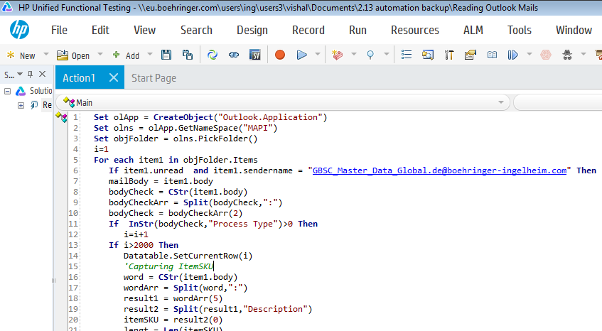
Automation Solution
Automation code uses HP UFT(Unified Functional Testing) tool inside Citrix. As, the tool is compatible with Outlook, it can easily read and get the sender and body details of any mail.
It scans and captures approx. 1000 mails in 10 mins. <5 hours manual work in 10 mins>
6 months savings => 87 hours
Note : The mails which are identical and have a pattern can be automated using the tool.

Slide 4
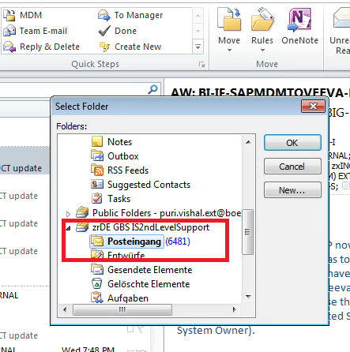
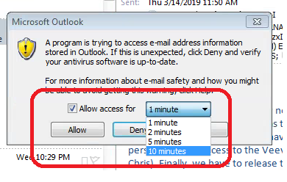
Work required
Order/install HP UFT tool from MyShop.
Run the script and select the outlook folder(shown in Fig. 1)
Allow the outlook to read the mails.(Maximum time allowed is 10 mins as shown in Fig. 2).
The code will read the unread mails and capture the mail body one by one.
Note : We can manipulate the captured mail body to get any required information we want.
Fig. 1
Fig. 2

Slide 5
Thank You!

